Slide 1
Time And Productivity Analysis
TEAM MEMBERS
1.Monika D [711715104041]
2.Vigneshwari R [711715104703]
3.Vignesh k [711715104068]
Facultyguide : Industrial Guide:
Vivekanandhan .V Abinaya
Assistant professor
Department of CSE
Department of CSE, KGiSL Institute of Technology, Coimbatore

Slide 2
Abstract
Productivity Analysis is conducted to identify areas for potential productivity improvement projects based on statistical data collected during the analysis. The analysis also pinpoints areas of delays and interruptions that cause loss of productivity.
In any productivity improvement initiative is to understand the current state of the operation. Productivity analysis provides baseline indicators that will also yield data which will be used to determine possible productivity improvement objectives and potential cost savings.
Department of CSE, KGiSL Institute of Technology, Coimbatore

Slide 3
Area Introduction-Existing system
In ancient days to improve productivity the log details are maintained in the notebooks manually,later it is computerised.
Even though it does not have any detailed information about where the employees spend more time.
Department of CSE, KGiSL Institute of Technology, Coimbatore

Slide 4
Proposed System
Advantages over existing methods:
Monitor performance and provide feedback
Diagnose problems
Facilitate planning and control
Future enhancement:
We are going to develope a web application which converts the log entery details in to graph so that the team head or manager can identify where the time is unneccessarily used.
Department of CSE, KGiSL Institute of Technology, Coimbatore

Slide 5
Literature Review
Drawbacks of existing methods
Strong self-discipline
Distractions
Resisting the fear of missing out(FOMO)
References
https://ideas.repec.org/cgi-bin/htsearch?form=extended&wm=wrd&dt=range&ul=&q=Productivity+analysis+in+IT+company&cmd=Search%21&wf=4BFF&s=R&db=&de=
Department of CSE, KGiSL Institute of Technology, Coimbatore

Slide 6
Architectural Design (DFD and/or ER diagram)
Graphical representation
documentation
Database
Blocking websites
design
Login
testing
Time Alert Notification
User
Register
Report generate

Slide 7
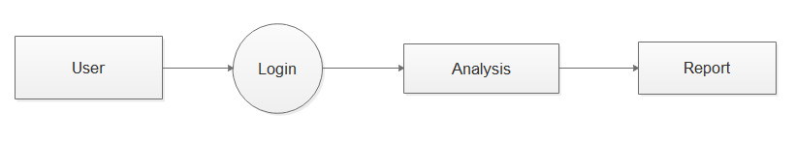
DFD
Level 0: Productivity analysis

Slide 8
Level 1: Generating Graphical Report

Slide 9
Module Splitup
Module 1 :
System study
User Interface
Module 2:
Graphical Representation
Module 3:
Blocking Websites
Module 4:
Notification

Slide 10
SCREEN SHOTS OF MODULES UNDER PROGRESS.

Slide 11
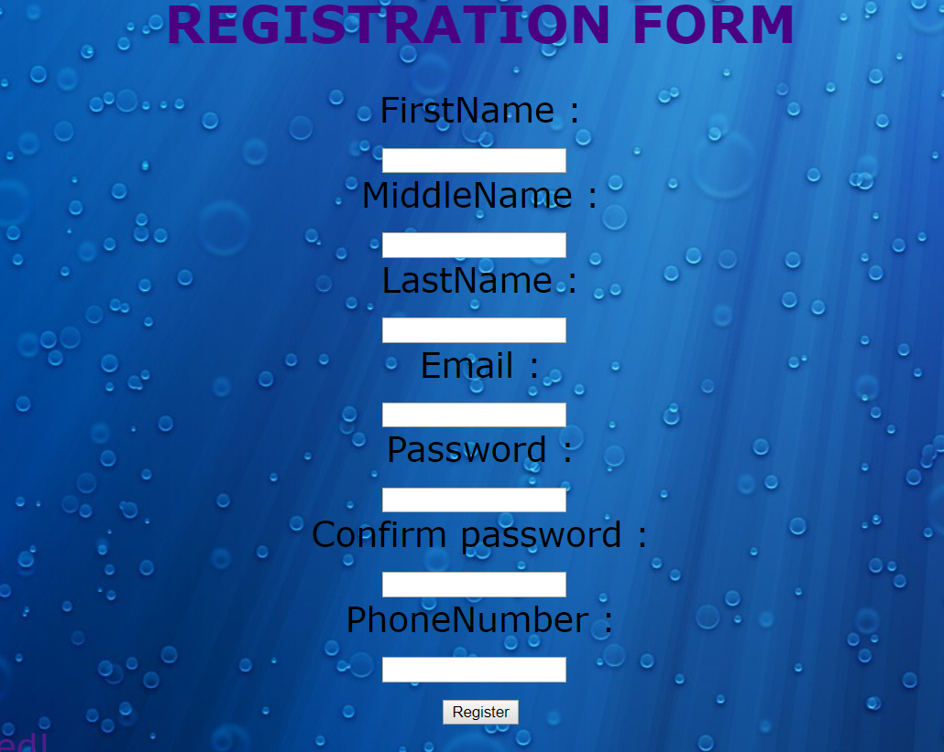
REGISTERATION

Slide 12
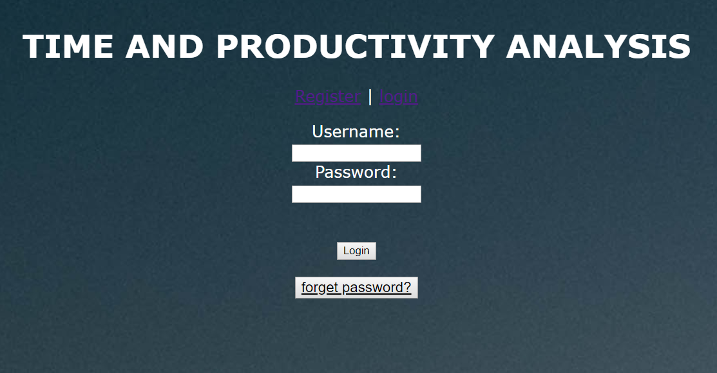
LOGIN

Slide 13
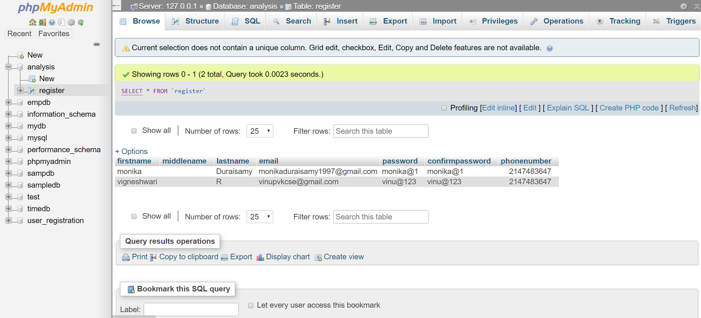
DATABASE

Slide 14
CONCLUSION
The user interface has been designed.A database has been created to store the details of the user or employees. And also the user interface is connected to the database.

Slide 15
Thank You!!!

